Slide 1
WEB APPLICATION CACHEPRINT ATTACK
Advisors: Dr Yossi Oren, Anatoly Shusterman
Team members: Chen Finkelstein, Yarin Abergel & Ofir Gruner

Slide 2
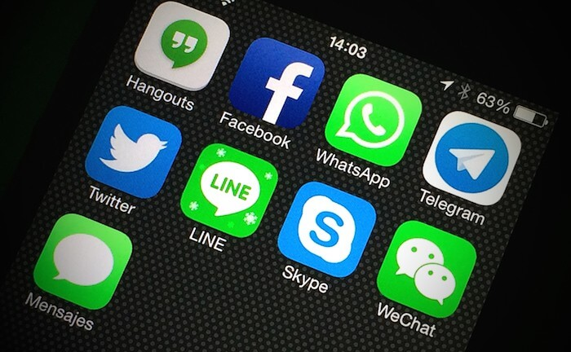




Chatting
File Transfer
Emailing
Web Browsing
VOIP

Slide 3
PROBLEM
How can we characterize the use of these applications?

Slide 4
OUR GOAL
Classification of application use using last level cache side-channel attack and network traffic analysis

Slide 5
Motivation
Profiling application activity in an accessible, light-weighted method
Can be exploited later in order to identify abnormalities

Slide 6
BACKGROUND
WHAT IS LAST-LEVEL CACHE SIDE CHANNEL ATTACK?
Last level cache (L3) is shared between all the cores
Use Prime & Probe technique
Collect traces of cache occupancy while using applications

Slide 7
Previous Work
Traffic characterization using network traffic analysis
Classification of websites using cache fingerprinting

Slide 8
OUR WORK
Implemented python programs for simulating applications use
Collected data from both last level cache and network traffic
Used Machine Learning techniques to analyze the data - CNN

Slide 9
OUR RESULTS
Preliminary 10 fold cross validated results using CNN model : 63±2.1%

Slide 10
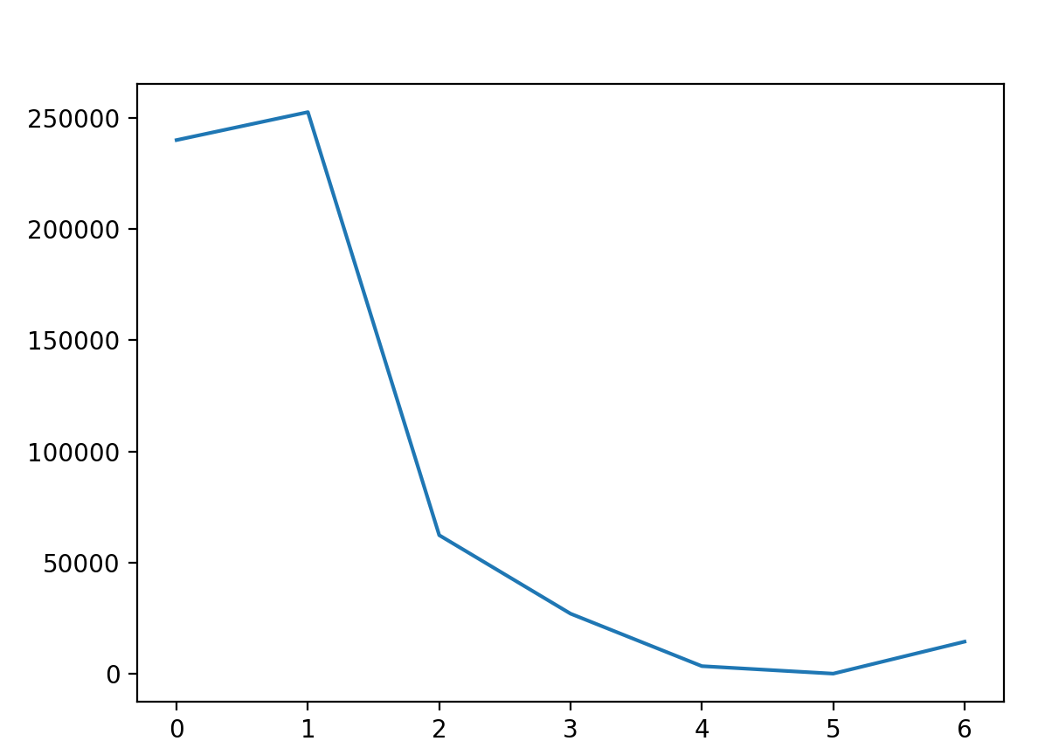
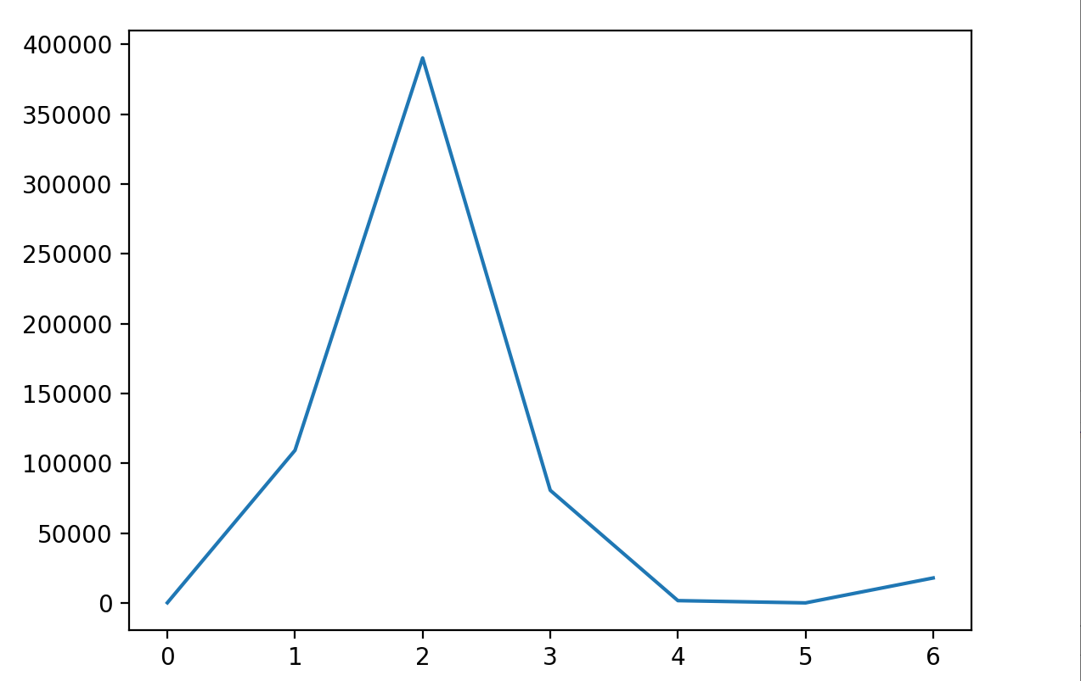
OUR RESULTS
CHATTING
VOIP

Slide 11
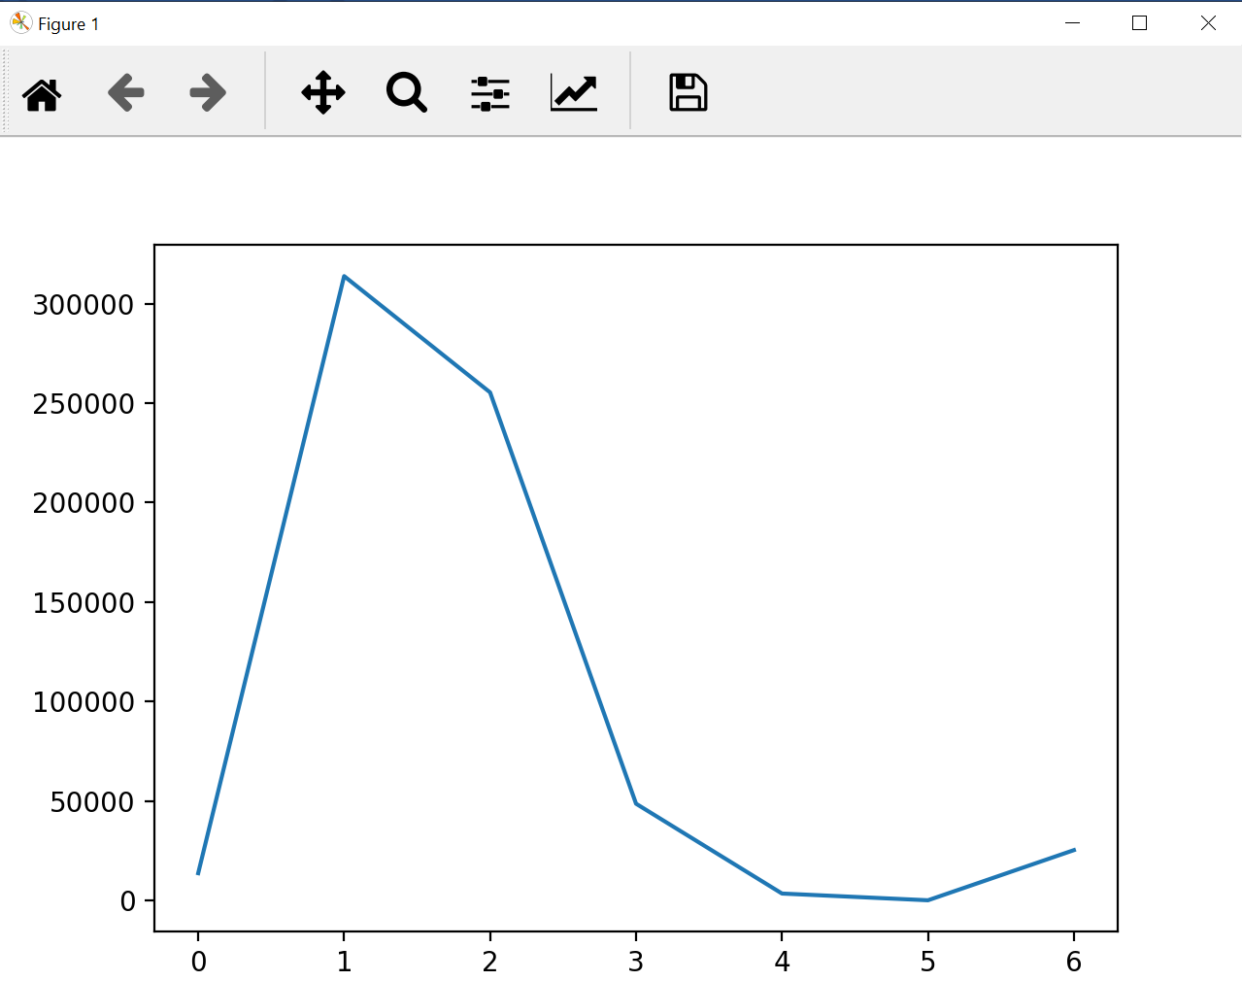
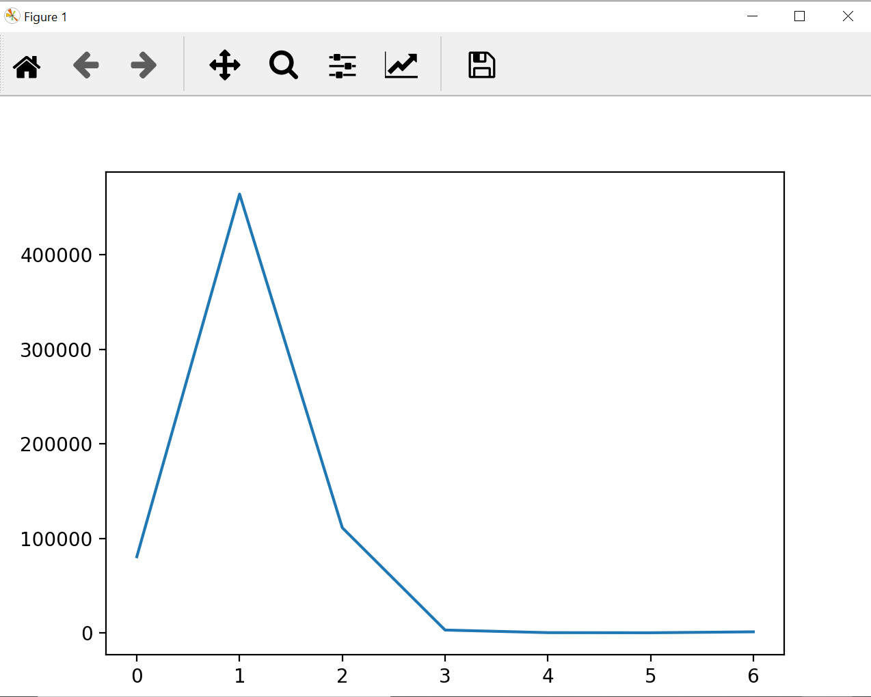
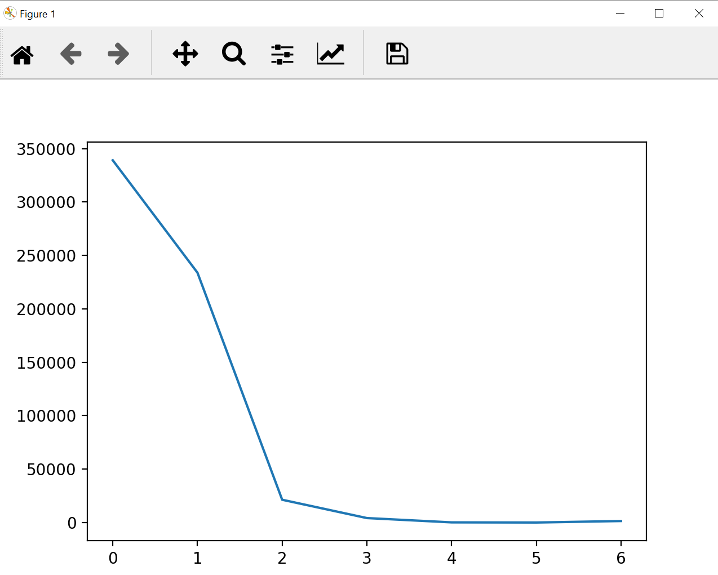
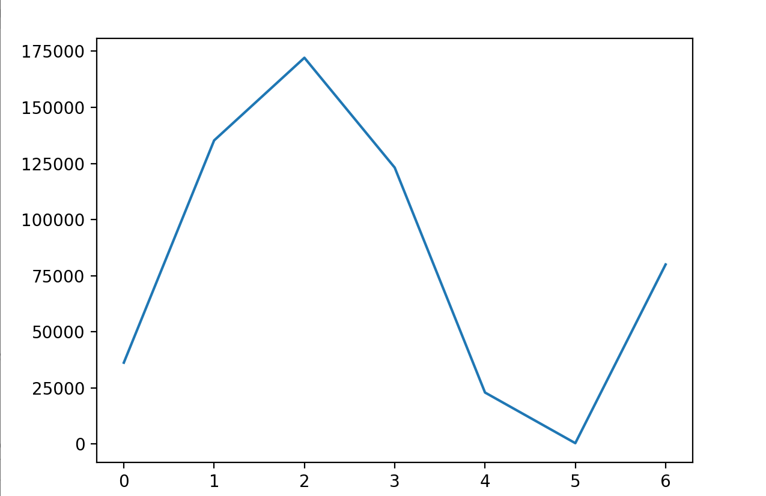

Slide 12
THANKS
chenfi@post.bgu.ac.il
yarinab@post.bgu.ac.il
ofirgru@post.bgu.ac.il

